Slide 1
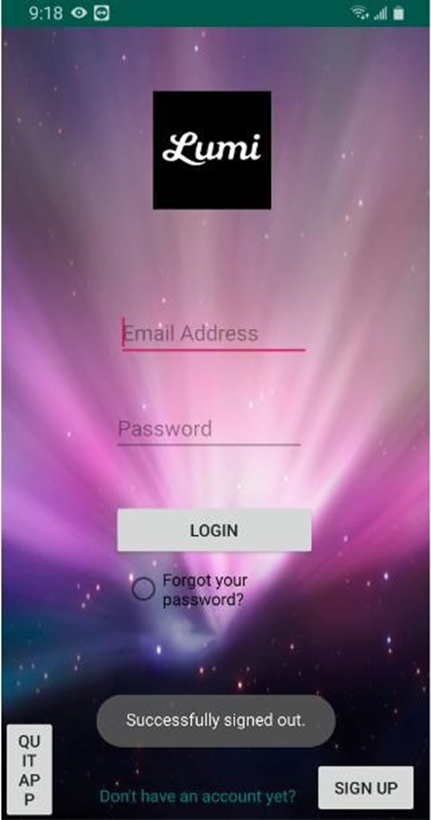
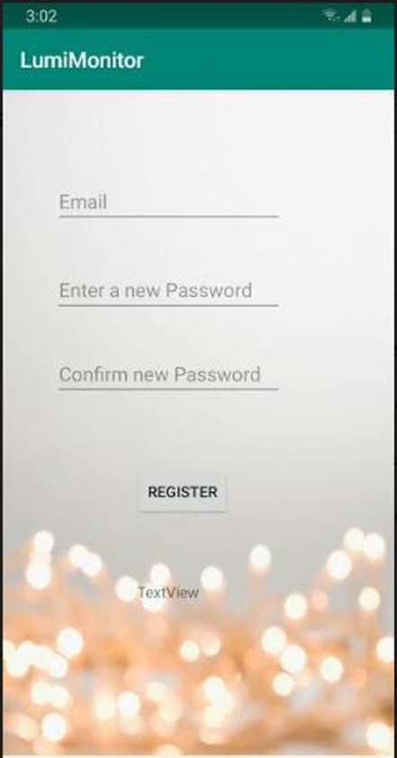
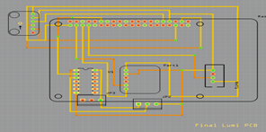
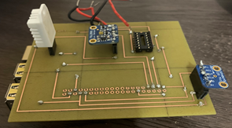
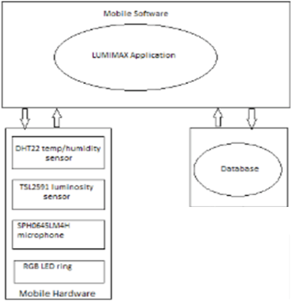
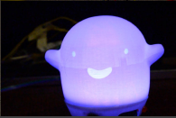
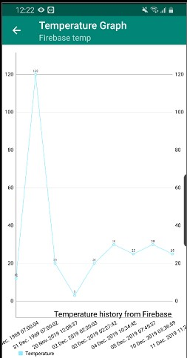
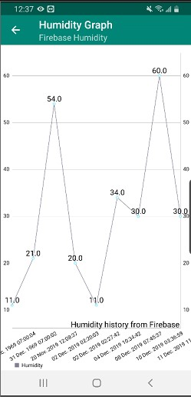
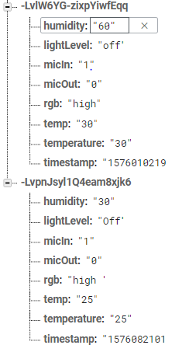

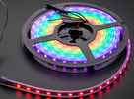
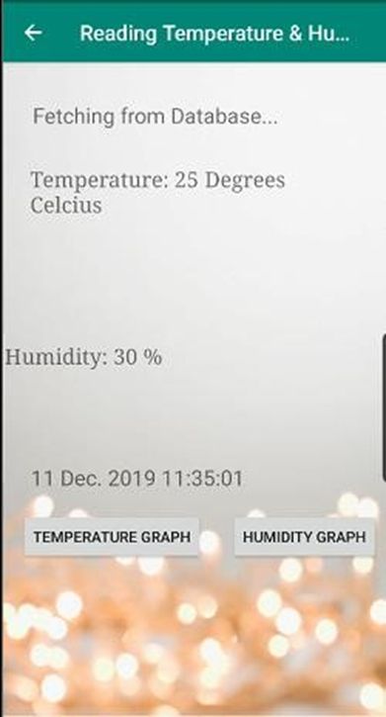
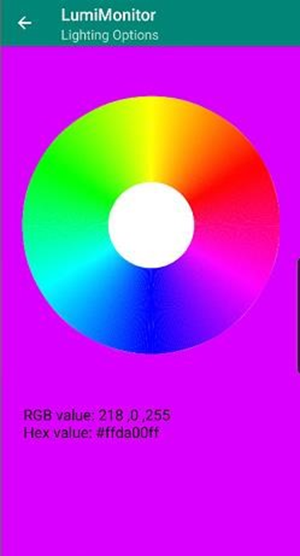

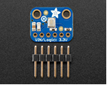
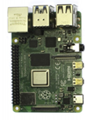

Lumi Monitor
Manshur Ramhith, Deval Rajgor and Abdirashid Yusuf Computer Engineering Technology, School of Applied Technology, Humber College North Campus
INTRODUCTION
Goal: Make parenting easier
Our project, the Lumi Monitor is intended to ease the life of parents by keeping track of the living conditions of their infants and ensuring the safety and comfort of their baby through installation of an integrated hardware in the baby’s room. In this project we used three sensors namely: Tsl2591(Light sensor) along with a Neopixel ring, DHT22 (Temperature & Humidity Sensor), SPH0645LM4H (Microphone Sensor). This project is unique since it allows parents to use a variety of functionalities through an Android app with a friendly User interface. The main hardware board that we are using to implement the project is the Broadcom Development platform, the raspberry pi 3B+.
Database & Block Diagram
Procedure to setup Database
• Get JSON file from firebase’s website after creating database.
• Configure gradle files in android studio to get the app to work in real time with firebase.
• On the hardware, install python firebase library firebase
• Import JSON & firebase in python code
1. from firebase import firebase
2. import json
firebase = firebase.FirebaseApplication('https://lumi-8b774.firebaseio.com/', None)
RESULTS
Images
FINAL DESIGN & PCB
. P
PCB Design using Fritzing Software
Login Screen
Registration Screen
Block Diagram of how system works with all of its components.
Final PCB with sensors attached and mounted on top of RPI
CONCLUSIONS
• Temperature & Humidity Monitoring
• 2-way communication channel
• Light & Sound Detection
• Signal Processing Circuit
• Android Mobile Remote Control
• RGB light controlled by color wheel
End Devices
Graphical representation of Temperature & Humidity from Firebase data
DHT22 Temperature & Humidity Sensor
Neopixel LED Strip
Firebase Database Design to accommodate data.
TSL2591 Luminosity Sensor
SPH0645 Microphone Sensor
ACKNOWLEDGEMENTS
Check to make sure you’ve acknowledged partner and funding agencies, either with text or with their logos.
Temperature & Humidity Data retrieval
Color Wheel for adjusting color of Neopixel LED Strip
Broadcom Development Platform (RPI 3B+)

